Slide 1

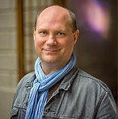
Arnold BARNA
Electrical engineer since 2000 (energy sector, University of Óbuda)
English (C1)
German (B2)
Seasoned project manager
08.12.2017

Slide 2
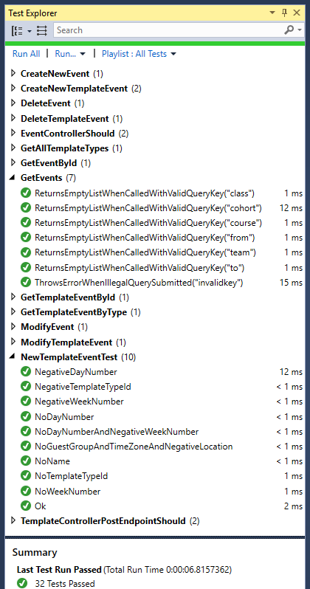
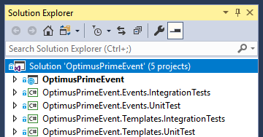
Quality Assurance - Testing

Slide 3
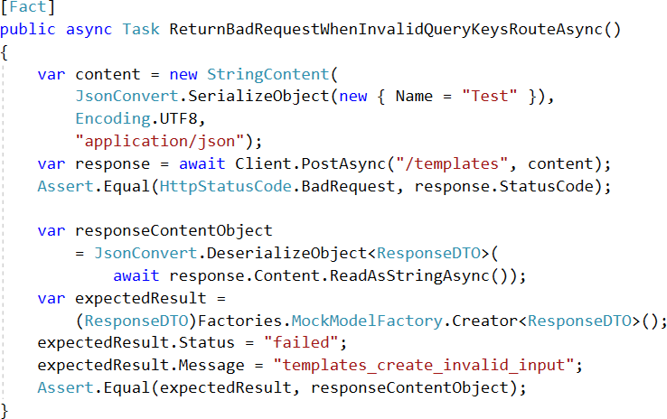
Integration Test for async POST
Test for status code
Test for JSON response

Slide 4
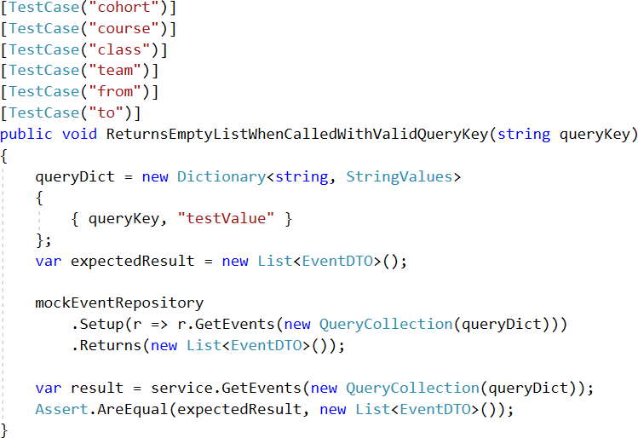
Unit Test for valid query keys

